Slide 1
Phase 3: 3D knapsack problem
René Steeman Michal Jarski
Lindalee Conradie Samuele Torregrossa
Max Persoon Ali Al-Saeedi
Drago Stoyanov
Group #25

Slide 2
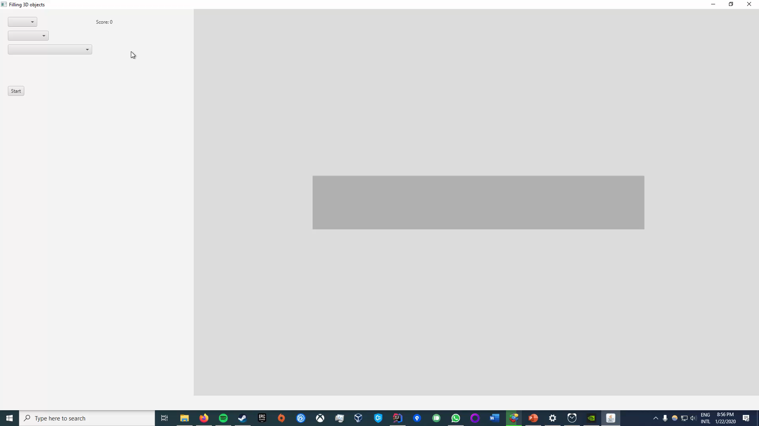
UI
2D input
3D output
Movement
Layer slider
Representation of objects

Slide 3

Greedy algorithm
Two versions:
Value based
Ratio (value/volume) based
Why different versions?
How does it work?
Why was it implemented?

Slide 4
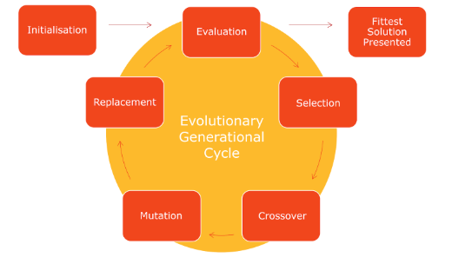
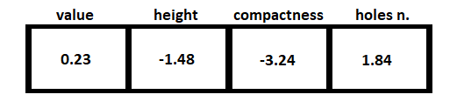
Genetic algorithm
Adapted from our pent-Tetris algorithm
Can improve by training
Good compromise for results, performance
Can easily be retrained for different constraints in the problem

Slide 5
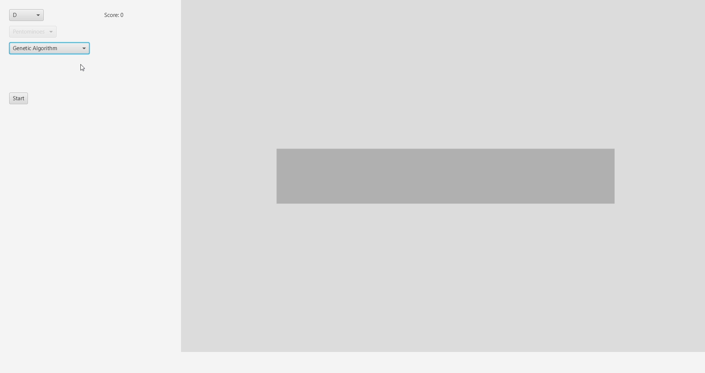
Maximize height

Slide 6

Minimize height

Slide 7

Minimize height and holes

Slide 8
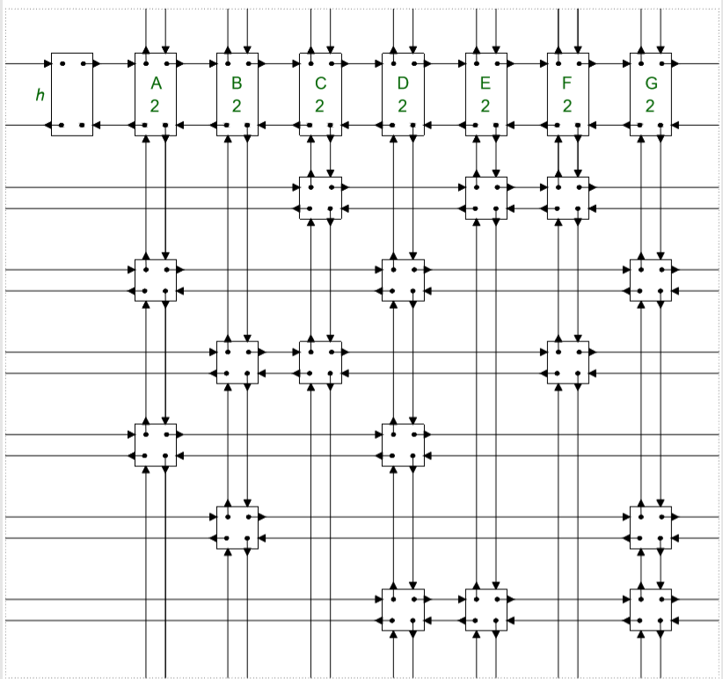
Dancing links
Algorithm X with dancing links
The use of dancing links is useful because it reuses the objects which prevents insertion of objects.
Modified to work with partial solutions
The algorithm attempts to fill the container and removes overlapping parts.
The solution with the highest score is picked.
Notes:
When either the pentominoes or parcels are chosen, the algorithm changes so it works for one of them.
The scoring method we use is the type of the pentominoe/parcel multiplied by the value of the chosen type.
After we get the score, the score is sent to the algorithm, and this part is the communication between the score and the algorithm.

Slide 9
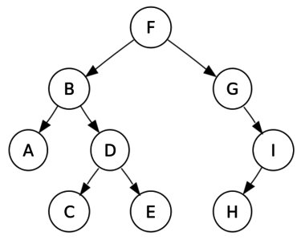
Optimization
Greedy approach:
-the algorithm now chooses the shape with the highest value to volume ratio first.
Pruning:
-it was used to further optimize the partial-cover problems.
-the score of the partial solution is now compared to the best score so far multiplied by a chosen value. If the score is above the threshold the branch will continue, otherwise it will be abandoned.

Slide 10
Different algorithms
 | Precision | Speed | Versatility | Difficulty to implement
Greedy | Low | Very fast | Medium | Easy
Genetic | Medium | Fast | High | Medium
X | Extreme | Very slow | Low | Medium
X modified | High | Decent | Medium | Hard
Greedy algorithm
Genetic algorithm
Algorithm X

Slide 11
Results
 | A | B | C | D
GBot |  | 231 |  | 1192
Greedy( value) |  | 230
Greedy( value/ volume) |  | 192
X modified | Not possible | 232 | yes | 1209

Slide 12
Results (General Question)
Pentominoes | Results
Gbot | 140
Greedy( value) | N/A
Greedy( value/ volume) | N/A
X modified | N/A
Parcels | Results
GBot | 128
Greedy( value) | 126
Greedy( value/ volume) | 1120
X modified | N/A
L
Amount: 30
Value:2
P
Amount: 20
Value:1
T
Amount: 30
Value:2
A
Amount: 30
Value:2
B
Amount: 20
Value:1
C
Amount: 30
Value:2

Slide 13
Conclusion
Packing problems have been extensively studied as they are so essential for operating supply chains and reducing unnecessary cost, such as cost of additional shipment.
The results illustrate that the proposed algorithms are successful. Good quality results can be obtained for large instances in a reasonable time.
As exact algorithms need more time to find a solution, we used heuristic algorithms as an alternative to find optimal or near optimal solution.

Slide 14

We learned a lot about
Different algorithms
Good communication between members
Dividing the work well

Slide 15

Any questions?

